Slide 1

Engineering Practices – Part I
Kovai.Library
Umamaheswaran (UMW360)
BizTalk360

Slide 2
Why do we never have time to do it right, but always have time to DO IT OVER?

Slide 3
Engineering Practices
General Practices
Agile Practices
Design Thinking

Slide 4
General Engineering Practices
Coding Practices
Code Review Guidelines
Code Analysis
CI/CD
Testing

Slide 5
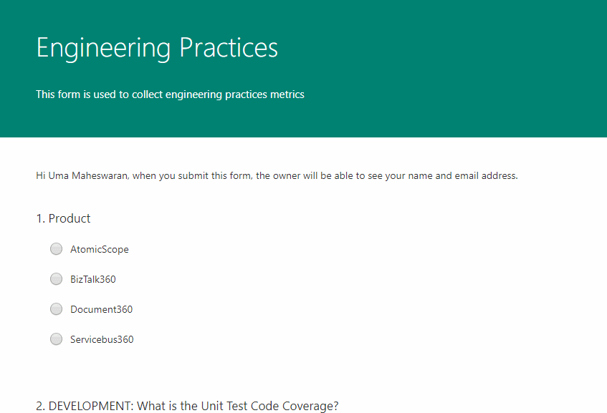

Slide 6
Paint Points of Software Code
Lack of abstractions
Mixed Responsibilities
Untestability
Metrics
Unit test coverage
Cyclomatic Complexity

Slide 7
Before software can be reusable it first has to be usable first.

Slide 8
Why we need an enterprise library
Reusability
Component based development
Clear abstraction
Easy to manage
Better control over standards
Easier to add new features

Slide 9
Rules of engagement?
Adhere to SOLID principles
Participate in Code Reviews
Share Ideas
Code merges will be done by Git Pull requests

Slide 10
How to contribute?
https://kovai.visualstudio.com/_git/Kovai.Library
Git Flow

